Slide 1
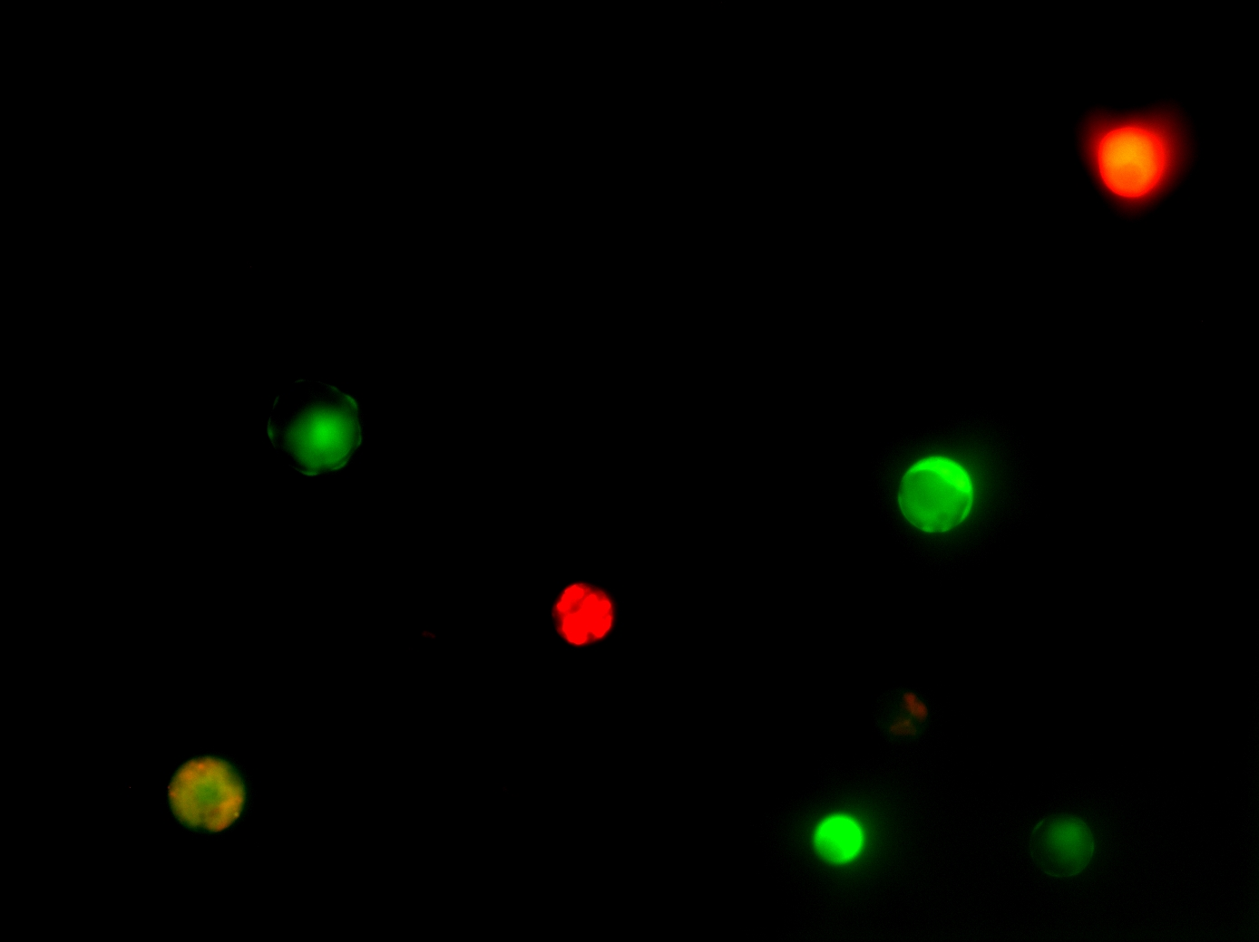
F. esculentum x F. esculentum
Dyes
- Rhodamine isothiocyanate (•)
- FDA (•)
Electrofusion parameters
AC |  |  | DC
V | Duration (s) |  | V | Length (s) | Pulses
15 | 15 |  | 100 | 20 | 2
100μm
(→) fused protoplasts

Slide 2
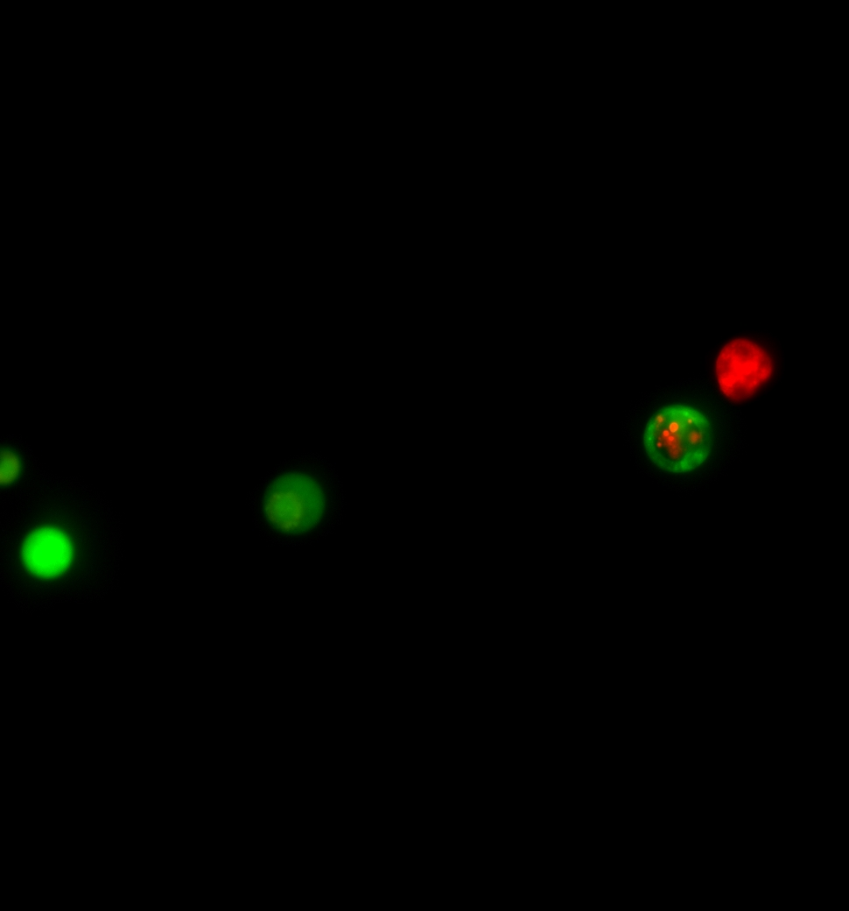
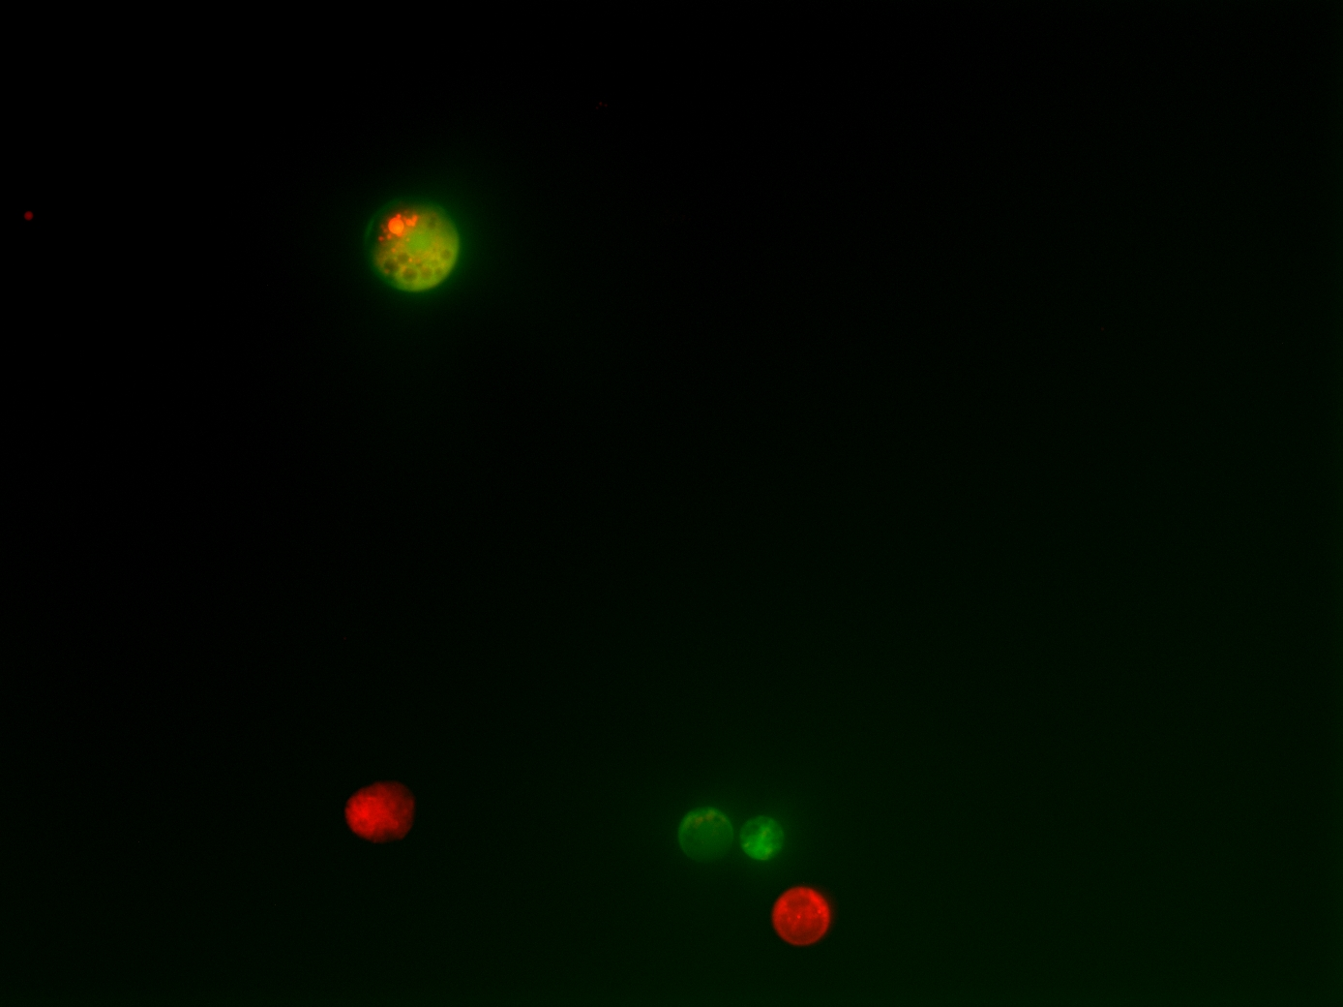
F. esculentum x F. esculentum
F. esculentum x F. esculentum
100μm
100μm
(→) fused protoplasts

Slide 3
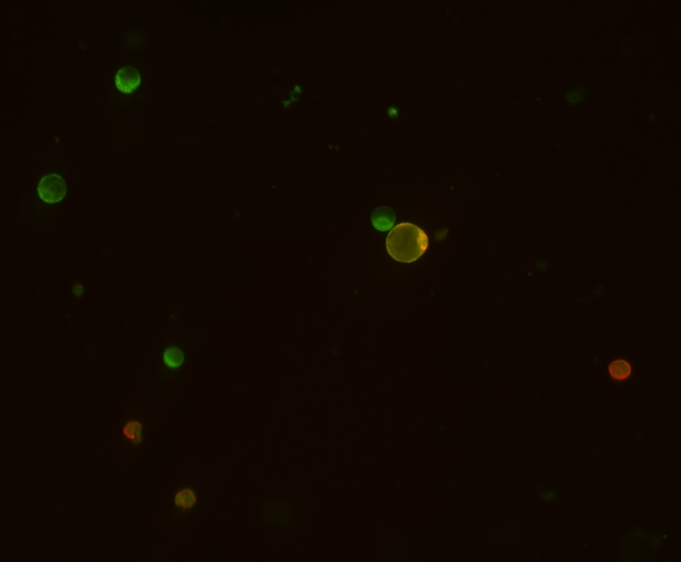
F. tataricum x F. tataricum
Dyes
- Rhodamine isothiocyanate (•)
- 3,3’-dihexyloxacarbocyanine iodide (•)
Electrofusion parameters
AC |  |  | DC
V | Duration (s) |  | V | Length (s) | Pulses
15 | 15 |  | 100 | 20 | 2
100μm
(→) fused protoplasts

Slide 4
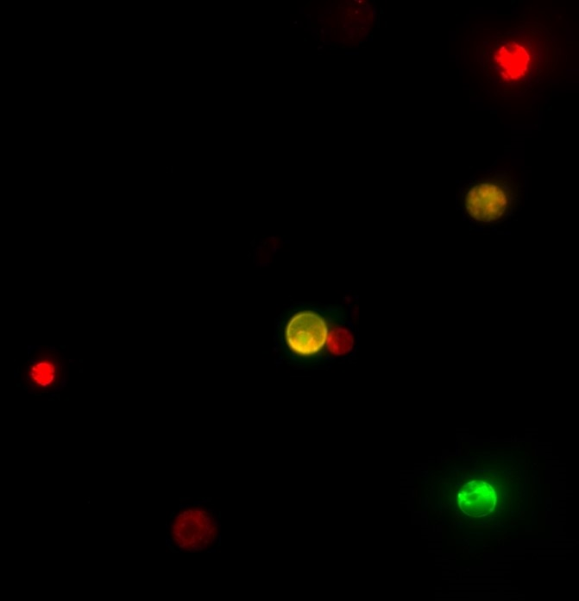
F. tataricum x F. esculentum
Dyes
- Rhodamine isothiocyanate (•)
- FDA (•)
Electrofusion parameters
AC |  |  | DC
V | Duration (s) |  | V | Length (s) | Pulses
15 | 15 |  | 200 | 20 | 2
100μm
(→) fused protoplasts

